Slide 1
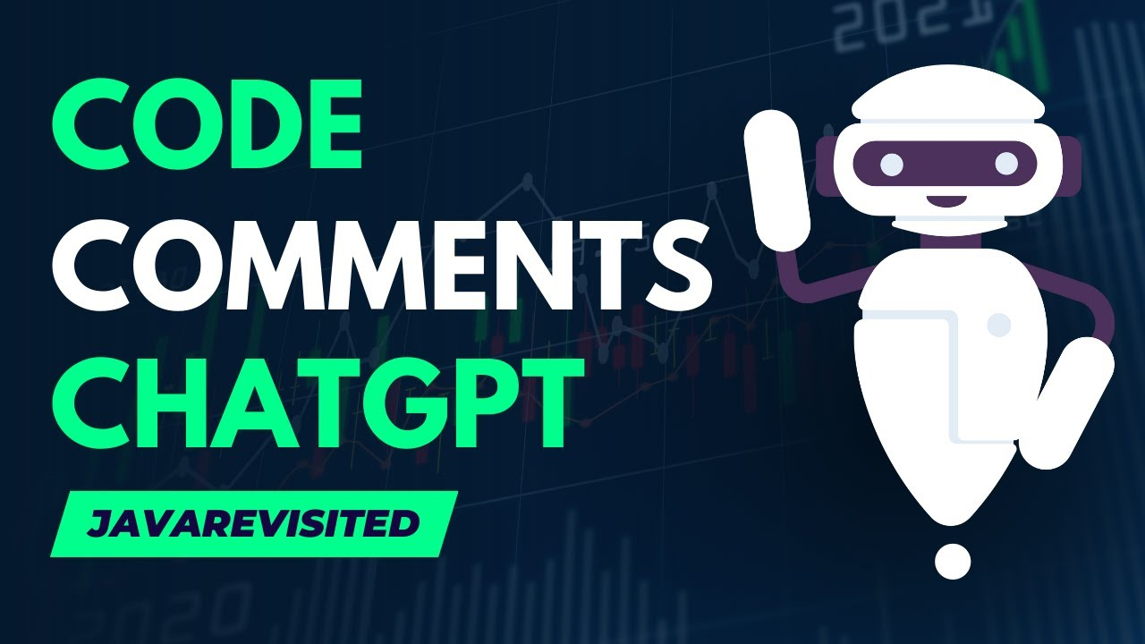
kgutdfuydfliyfl;
ChatGPT’s Ability to generate comments for codes
Hassan
Abdul-Mohsen
Abdullah
Mishary

Slide 2
Introduction
Exploring LLMs abilities and Limitations.
How well can it write code comments?
Is Human-Documentation Superior

Slide 3
01
“A Comparative Analysis of Large Language Models for Code Documentation Generation”

Slide 4
Idea
Evaluate the effectiveness of LLMs in generating code documentation
comparing Ai models across different documentation levels (inline, function, and file-level).

Slide 5




AI Models Used:
01
02
03
04
GPT-3.5, GPT-4
Bard
Llama2
StarChat - Beta

Slide 6
Method
checklist-based evaluation approach
14 Python code snippets from well-documented open-source projects
(Bitcoin, TensorFlow, SQLAlchemy, Scikit-Learn, and Reddit)
generate documentation using prompts
two expert reviewers assess the output

Slide 7
Evaluation metrics used:
01
Accuracy
04
Understandability
02
Completeness
05
Readability
03
Relevance
06
Time Taken

Slide 8
Results

Slide 9
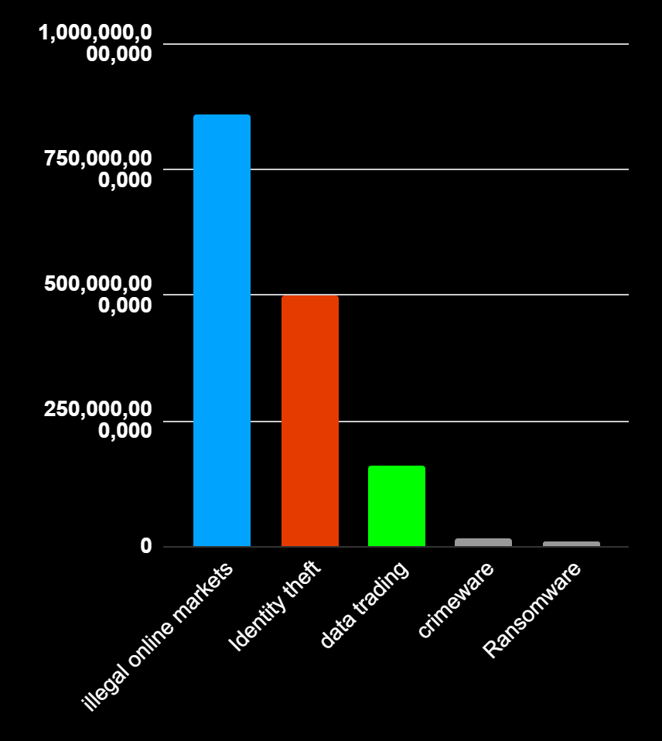
ChatGPT
#1
Best quality, time consuming
Bard
#2
Superior to Human-Documentation
Llama
#3
Performance Lacking
StarChat
ChatGPT
Bard
Llama
StarChart
#4
Weakest Comment Generation

Slide 10
02
“Automatic Code Summarization via ChatGPT: How Far Are We?.”

Slide 11
Idea
investigate ChatGPT's effectiveness in automatic code summarization
comparing performance against state-of-the-art (SOTA) models

Slide 12
Method
Design prompts to guide ChatGPT in generating comments for code snippets
Utilize the CSN-Python dataset for code test set.
Compare summaries with those produced by SOTA models

Slide 13
Evaluation Metrics
measure the quality of generated text against reference summaries, using the following metrics:
BLEU
METEOR
ROUGE-L

Slide 14

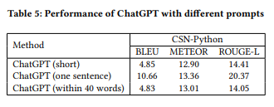
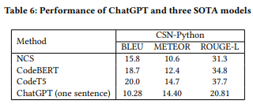

Slide 15
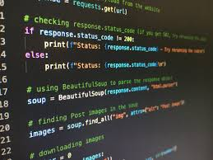
Results
ChatGPT's performance was significantly lower than SOTA models.
ChatGPT's code summaries were less aligned with reference summaries than those produced by other models

Slide 16
03
“Using GPT-4 for Source Code Documentation.’’

Slide 17
Idea
Investigates GPT-4's effectiveness
generating Java class-level and method-level documentation
compare to manually written reference documentation.

Slide 18
Method
using predefined prompts.
GPT-4 generates Javadoc comments for class and method levels.
Output is evaluated using both automated (BLEU, ROUGE) and manual methods.
Select Eleven Java classes and 55 methods from open-source projects

Slide 19
Evaluation metrics used:
01
Correctness
04
BLEU
02
Completeness
05
ROUGE-1
03
Conciseness

Slide 20
Results
Document Level: GPT-4 is more accurate than the reference but slightly less complete.
Class Level: GPT-4 performed poorly in completeness, correctness was high.
Method-level: BLEU and ROUGE scores were significantly higher than other levels.

Slide 21
04
“Can Developers Prompt? A Controlled Experiment for Code Documentation Generation.’’

Slide 22
Idea
Study how well both students and professionals, can prompt LLMs to generate code documentation
compare ad-hoc prompts with predefined few-shot prompts.

Slide 23
Method
controlled, between-subject experiment
Used 2 Python functions to document
Ad-hoc group craft unique prompts
Control group used pre-defined prompts

Slide 24
Evaluation metrics used:
01
Correctness
04
Usefulness
02
Missing Information
05
Helpfulness
03
Unnecessary Information
06
Readability

Slide 25
Results
Predefined prompts produced higher-quality documentation.
Professionals performed better with ad-hoc than students
Both tools improved code understanding.
Tools performed best with complex functions

Slide 26
05
“The Role of ChatGPT in Computer programing.’’

Slide 27
Idea
explore the role and capabilities of ChatGPT in computer programming
focus on how ChatGPT can assist developers
Study ChatGPT ability to offer features such as code completion, error correction, optimization, and documentation generation

Slide 28
Method
Giving ChatGPT prompts.
Analyzing its ability to:
Predict code snippets
Fix syntax errors
Suggest optimization
Generate documentation

Slide 29
Evaluation Metrics
No formal evaluation metrics are mentioned in the research.
the effectiveness of ChatGPT is assessed qualitatively through examples
Accuracy in code suggestions, error detection, and document generation.

Slide 30
Results
ChatGPT is a valuable tool for developers, helps reduce coding errors, improve code quality, and accelerate development processes.
ChatGPT is effective in providing automating documentation and refine code structure.
ChatGPT still requires human supervision for tasks.

Slide 31
CONCLUSION
06
LLMs showed better results than human-documentation
LLMs are reliable in code documentation
ChatGPT showed better performance than other LLMs

Slide 32

Thank you for listening!

